Slide 1

FACEMASK DETECTION ALERT SYSTEM
GURU NANAK DEV ENGINEERING COLLEGE,
LUDHIANA
SUBMITTED BY:
MANPREET SINGH (1706472)
Branch : D4CSE-A2

Slide 2
OBJECTIVES
1. To develop a Graphical User Interface (GUI), which will allow user to input an image and detect whether the person in that image is wearing a mask or not.
2. To create an environment where CNN neural network architecture is used to operate the input image and predict whether ‘Mask ON’ or ‘NO Mask’.
3. To send an alert email along with the attached image of that person in case if ‘NO Mask’ is predicted in the image.

Slide 3
OVERVIEW
Studies have proved that wearing a face mask significantly reduces the risk of viral transmission as well as provides a sense of protection. However, it is not feasible to manually track the implementation of this policy. Technology holds the key here.
I introduce a Deep Learning based system that can detect instances where face masks are not used properly. The system consists of a Convolutional Neural Network (CNN) architecture capable of detecting masked and unmasked faces. Further that can be integrated with pre-installed CCTV cameras. This will help track safety violations, promote the use of face masks, and ensure a safe working environment.

Slide 4
IMPLEMENTATION
In this project, we will be developing a facemask classifier trained using dataset containing 1,376 images: 686 images without mask and 690 images with mask and CNN architecture VGG16 neural network whose topmost layer is trained using transfer learning for predicting output. Once the facemask classifier is trained, we will create a GUI which uses facemask classifier to classify the face in input image as ‘Mask ON’ and ‘NO Mask’. In case of ‘NO Mask’ it will send an alert email containing attached image of that individual to authorities.

Slide 5
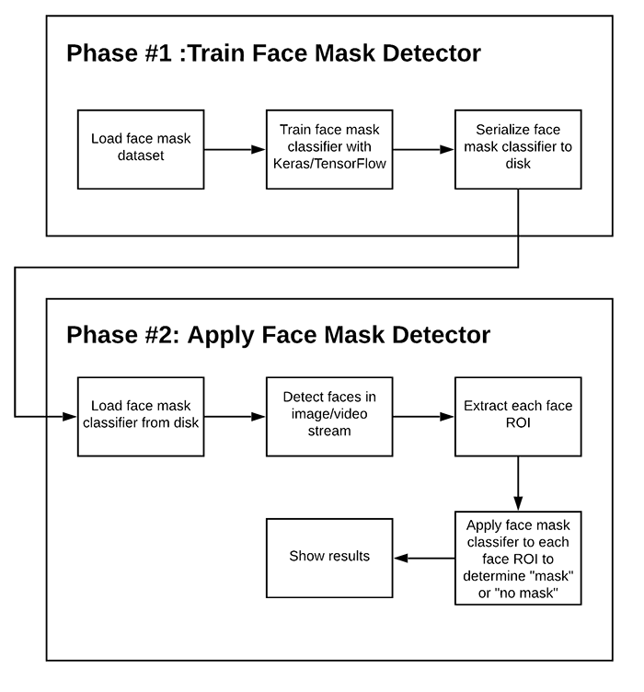
FLOW DIAGRAM

Slide 6
SOME IMPORTANT LIBRARIES USED
KERAS/TENSORFLOW :
Keras is a powerful and easy-to-use free open source Python library for developing and evaluating deep learning models. It allows you to define and train neural network models in just a few lines of code .
TensorFlow is an end-to-end open source platform for machine learning. It has a comprehensive, flexible ecosystem of tools, libraries and community resources that lets researchers push the state-of-the-art in ML and developers easily build and deploy ML powered applications.

Slide 7
OPENCV:
Computer vision is a multidisciplinary scientific field that operates on digital images or videos to automate tasks that the human visual system can do. Computer vision tasks include gathering, processing and analyzing the information from digital images. It is closely linked with Artificial Intelligence and Machine Learning as the computer must interpret what it sees and analyze the digital image in the same way as a human see.
SMTP:
Simple Mail Transfer Protocol (SMTP) is a protocol, which handles
sending e-mail and routing e-mail between mail servers. Python provides
smtplib module, which defines an SMTP client session object that can be
used to send mail to any Internet machine.

Slide 8
Python Matplotlib:
It is a very powerful plotting library useful for those working with Python and NumPy. And for making statistical inference, it becomes very necessary to visualize our data and Matplotlib is the tool that can be very helpful for this purpose. It provides a MATLAB like interface; the only difference is that it uses Python and is open source.
Tkinter:
Tkinter is the standard GUI library for Python. Python when combined with tkinter provides a fast and easy way to create GUI applications. Tkinter provides a powerful object-oriented interface to the Tk GUI toolkit. Creating a GUI application using Tkinter is an easy task.

Slide 9
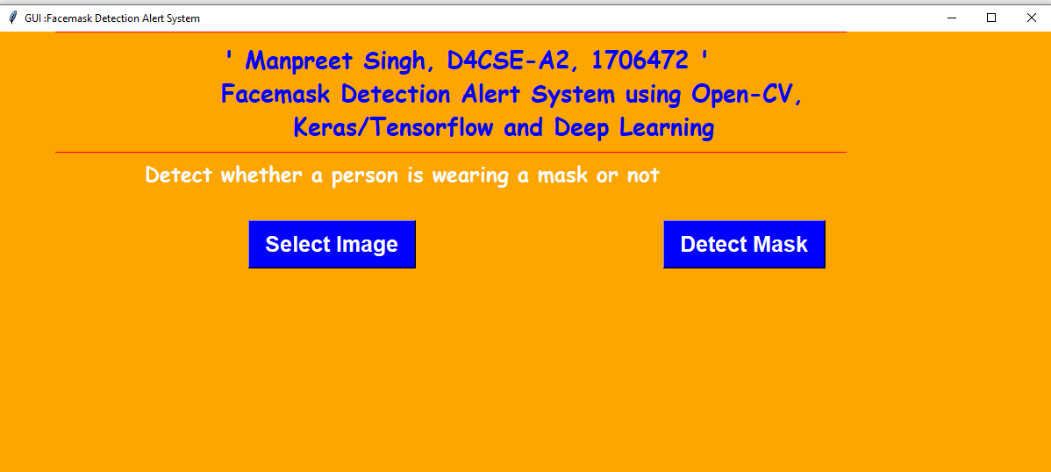
USER INTERFACE
Fig. Home page of Face Mask Detection System

Slide 10
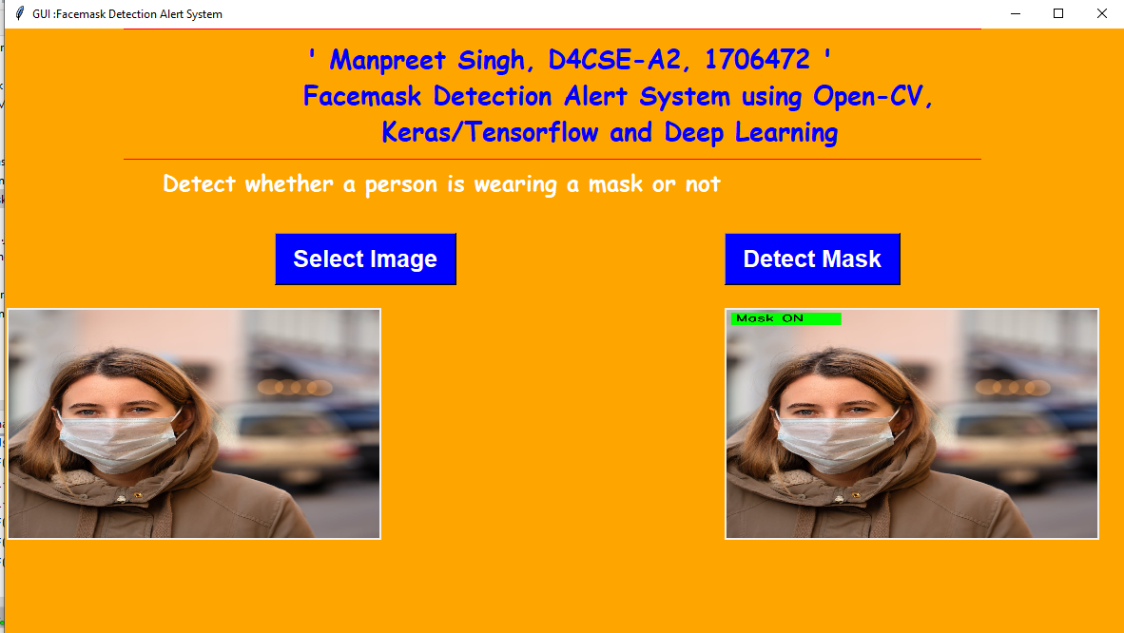
CASE-1 ‘MASK ON’
Fig. Output in case of person wearing a mask

Slide 11
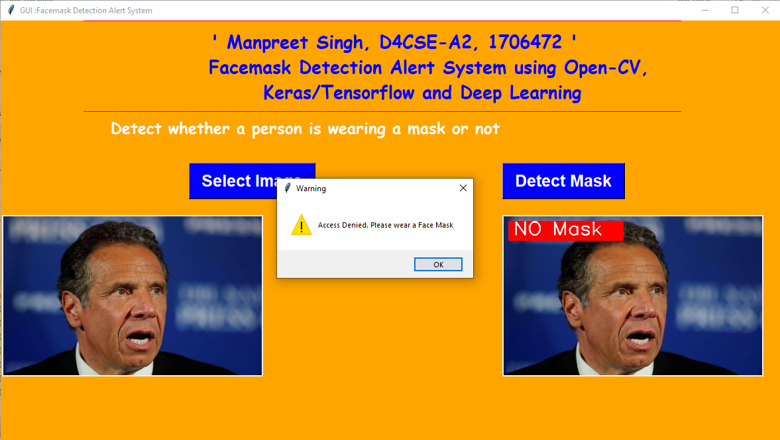
CASE-2 ‘NO MASK’
Fig. Output in case of person not wearing a mask

Slide 12
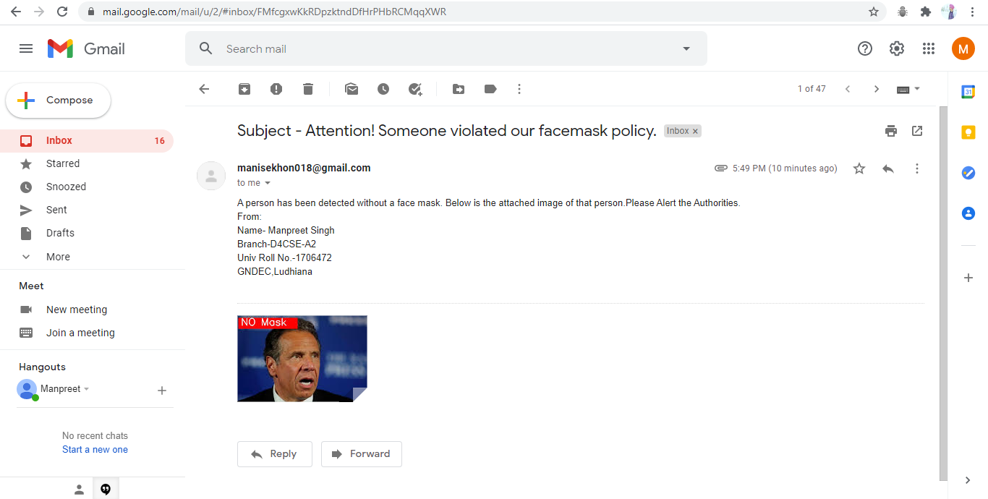
ALERT EMAIL SENT IN CASE OF ‘NO MASK’
Fig. Alert email sent to authorities

Slide 13
USEFUL APPLICATIONS OF THIS PROJECT
AIRPORTS:
The Face Mask Detection System can be used at airports to detect travelers without masks. Face data of travelers can be captured in the system at the entrance. If a traveler is found to be without a face mask, their picture is sent to the airport authorities
HOSPITALS:
Using Face Mask Detection System, Hospitals can monitor if their staff is wearing masks during their shift or not. Also, if quarantine people who are required to wear a mask, the system can keep an eye and detect if the mask is present or not and send report to the authorities.

Slide 14
OFFICES:
The Face Mask Detection System can be used at office premises to detect if employees are maintaining safety standards at work. It monitors employees without masks and sends them a reminder to wear a mask.

Slide 15
FUTURE SCOPE
It can be integrated with any existing cctv cameras and IP cameras to detect face mask in realtime.
Furthermore, an alarm system can also be implemented to sound a beep when someone without a mask enters the area.
It can be amended as and when requirement emerges, as it is versatile in terms of extension it can be implemented as an application on either Android or ios.

Slide 16
THANK YOU!

